Slide 1
Student Visa applications (non-EEA)
Student Advice and Support Service

Slide 2
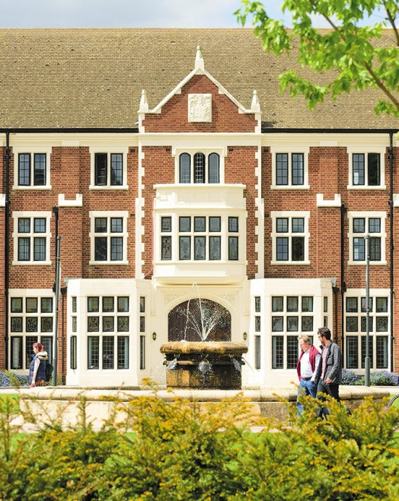
Introduction
SASS provides free advice
See our online visa guides for more detail
Contact for individual queries:
advice@lboro.ac.uk

Slide 3
Visa process overview
CAS issued by Admissions
Can apply up to 6 months before course start
Prepare in advance of applying
ATAS - allow extra time
Financial evidence
TB test
Application costs
Apply for visa in good time

Slide 4
The application process
Apply online
Pay visa fee and IHS
Book and attend VAC appointment
Standard 3 weeks target for UKVI decision
90-day vignette in passport
Collect Biometric Residence Permit (BRP) in the UK

Slide 5
How much will it cost?
Visa fee - £348
Immigration Health Surcharges (IHS) - £470 per year of visa
TB test costs - if required
Additional priority and VAC services fees – depend on location

Slide 6
CAS details
Sent by email as a pdf
Check personal and study details correct
University details including location of study
Sponsor licence number: G9M4TDXV1
Individual CAS number
English language details
Tuition fees charged and already paid (including PGT CAS deposit)

Slide 7
English language
CAS will confirm English language is at ‘CEFR B2’ for degree students
No evidence/documents required if CAS confirms:
UKVI Secure English Language Test (SELT) eg IELTS UKVI
The University’s assessment and that no documentary evidence is required
Otherwise – evidence may be required, see our guide

Slide 8
Academic evidence
Loughborough University is a ‘Higher Education Provider with a track record of compliance’
You do not need to prove qualifications that were used to secure your offer eg previous degree
You might still need to provide a qualification if that was how your English language ability has been assessed

Slide 9
ATAS
Only required for certain science and technology subjects
Some nationalities are exempt
Offer will confirm if ATAS is required
Free, online application, can take a month or more to be decided
ATAS clearance has 6 month validity for use in a visa application

Slide 10
Financial requirement
UKVI financial guidance
Calculated on the basis of outstanding tuition fees plus living costs
Outstanding tuition fees – as detailed on CAS
Typical living costs: Loughborough £9,135 (£9,207 after 1 Dec), London £11,385 (£12,006 after 1 Dec)
If relying on personal funds the total amount required should be kept throughout a 28-day period ending no earlier than 31 days before applying

Slide 11
Financial evidence
Certain nationalities won’t be asked to show financial documents but be prepared in case requested later
LU scholarships will be on CAS (fees will be discounted or a sponsor note can give details)
CAS can show any prepaid tuition fee (including any CAS deposit)
Types of evidence; bank statement, educational loan letter, ‘official financial sponsor’ letter
Extra evidence may be required if relying on parent’s or partner’s funds

Slide 12
Online application
Start here, can be saved and resumed later
Refer to your CAS and our guide
You can change your answers before you reach the ‘declaration’ stage
Contact Student Advice if needed
Choose where to collect your BRP
Pay online
Book and attend VAC appointment

Slide 13
Visa interviews
UKVI may interview some students and you may be asked about:
University and course details
Reasons for your choice of study
You funds being genuinely available
How the course is relevant to career plans
See our guide for more details

Slide 14
Visa decision
Granted:
90-day vignette placed in passport, valid for travel up to one month before the course start
Collect BRP after arrival in the UK
Visa refusal – seek advice about administrative review or reapplying

Slide 15
Graduate route
Expected to start Summer 2021
Will give individuals a general right to work including self-employment
Applications must be made in the UK while still holding Tier 4 or Student permission
Applicants must have passed the degree for which CAS was issued
2 year visa for bachelor’s and master’s graduates
3 year visa for PhD graduates
Full details expected in 2021

Slide 16
More about SASS
We look forward to seeing you at the University.
Our website has information on how we can help with
Visas
Housing
Money matters
Other legal issues

Slide 17
Q & A
Student Advice and Support Service
advice@lboro.ac.uk

